Slide 1

Project Work Phase-2(BCS685)
Reiew-1 Presentation on
“AI-Powered Real-Time Intrusion Detection System Using Deep Learning”
Presented by
Presented By, | Under the guidance of, Dr Suriya Begum Department of CSE, EPCET
Napa Guna Sai Sujith (1EP23CS107)
Pooja (1EP23CS114)
R Lavanya (1EP23CS127)

Slide 2

INTRODUCTION
Rapid growth of the internet and digital technology
Increase in cyber attacks on networks and systems
Common attacks: DoS, port scanning, and web attack
Traditional IDS uses fixed rules to detect attacks
Rule-based systems may miss new or unknown attacks
Need for an intelligent AI-based security solution

Slide 3
Problem Statement
Traditional intrusion detection systems rely on predefined rules and fail to detect new or evolving cyber threats. There is a need for an AI-based system that can automatically analyze real-time network traffic, identify abnormal patterns such as DoS and DDos, and provide accurate alerts with severity classification.

Slide 4
Significance of the Project
Provides high detection accuracy for known and unknown attacks.
Enables real-time threat detection and faster response.
Reduces manual monitoring effort.
Scalable for large enterprise and cloud networks.
Enhances protection for sectors like banking, healthcare, e-commerce, and government.
Supports proactive cybersecurity measures.

Slide 5
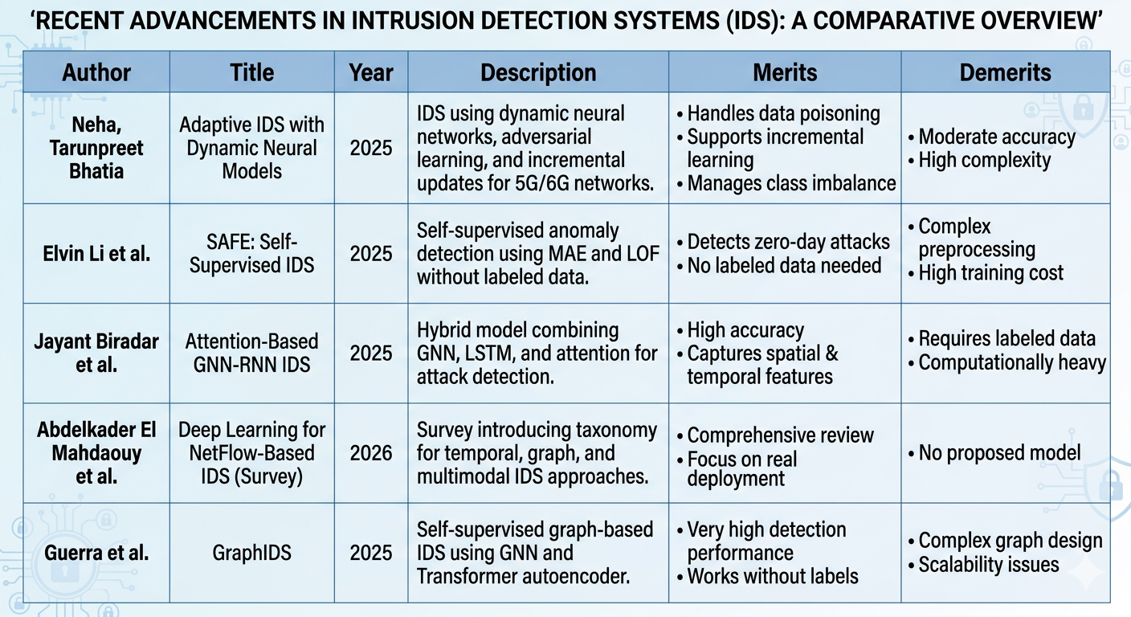
Literature Survey

Slide 6
Existing System And Limitations
Signature-Based IDS
Uses predefined attack signatures
Matches network traffic with known patterns
Rule-based detection approach
Example systems: Snort-type IDS
Supervised Deep Learning IDS
Uses CNN, LSTM, or hybrid models
Requires labelled attack data
Trained offline on static datasets
Mostly evaluated on benchmark dataset
Per-Flow Machine Learning IDS
Treats each network flow independently
Uses ML models like SVM, Random Forest, basic DNN
Performs classification on tabular flow features
Uses datasets like NSL-KDD, CICIDS
Limitations of Existing System
Detects only known attacks
Cannot detect new or zero-day attacks
Gives many false alarms
Needs frequent updates and retraining
Not suitable for complex and large network

Slide 7
Proposed System
AI-Based Intrusion Detection System (IDS)
Uses Machine Learning / Deep Learning models
Monitors network traffic in real time
Detects abnormal patterns automatically
Identifies attack type (DoS, Port Scan, etc.)
Generates alert with severity level
Displays results on a live dashboard
Can adapt to new and unknown attacks
Advantages of Proposed System
Detects both known and unknown attacks
Provides real-time threat detection
Reduces false alarms
Automatically learns new attack patterns
Classifies attack type and severity
Suitable for large and complex networks
Visualizes threats using live dashboard

Slide 8
Objectives
To design and implement a real-time AI-powered Intrusion Detection System.
To train a deep learning model using the CICIDS2017 , NSL-KDD datasets.
To detect and classify various types of network attacks such as DoS and port scan.
To provide severity levels and recommended mitigation actions for detected attacks.

Slide 9
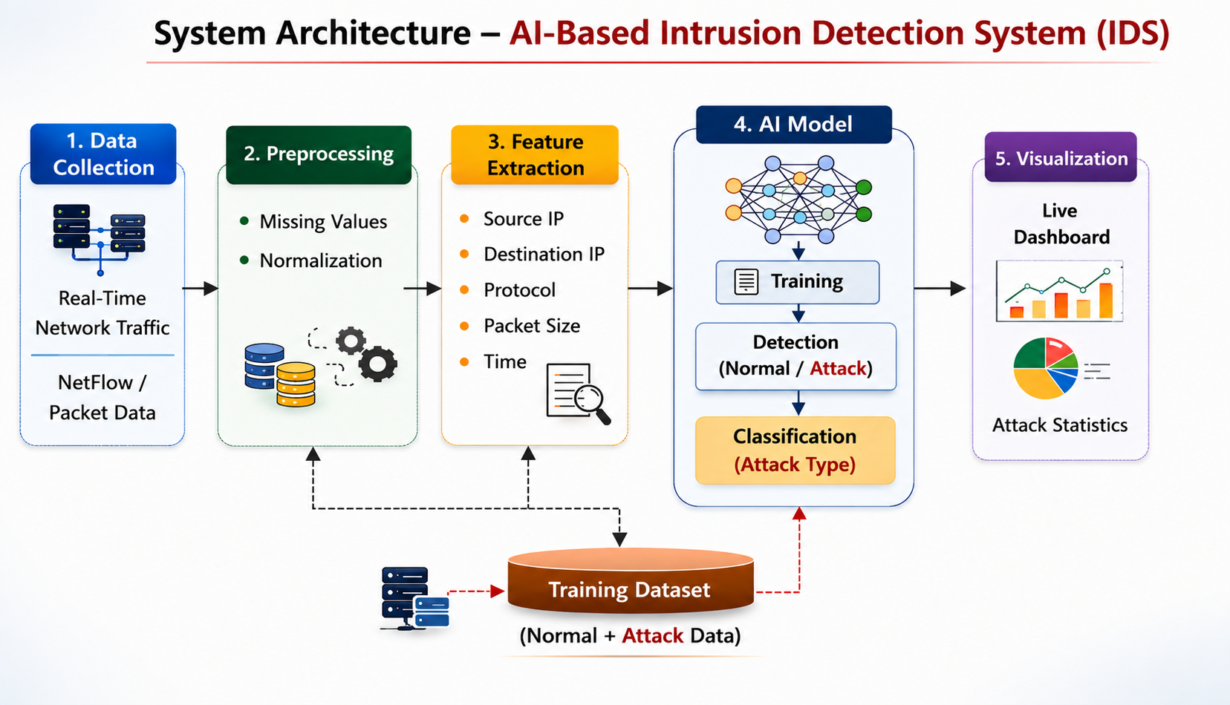
System Architecture

Slide 10
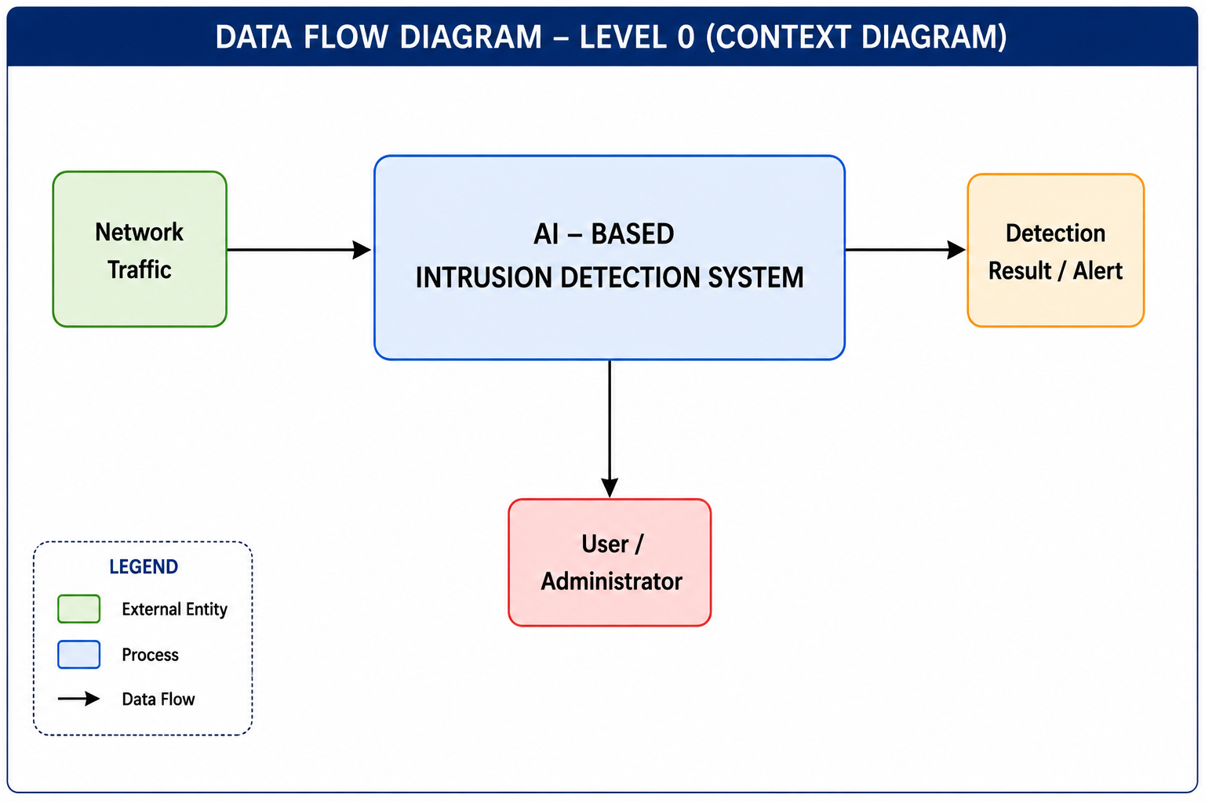

Slide 11
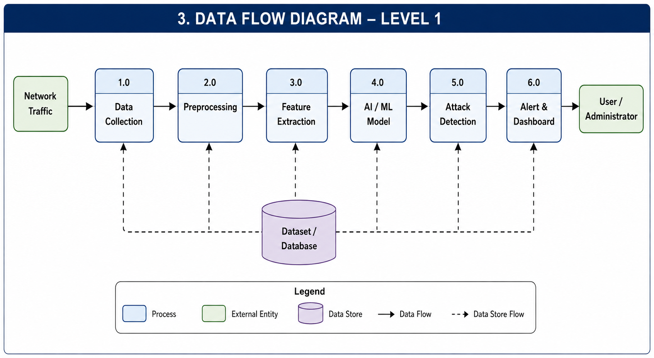

Slide 12
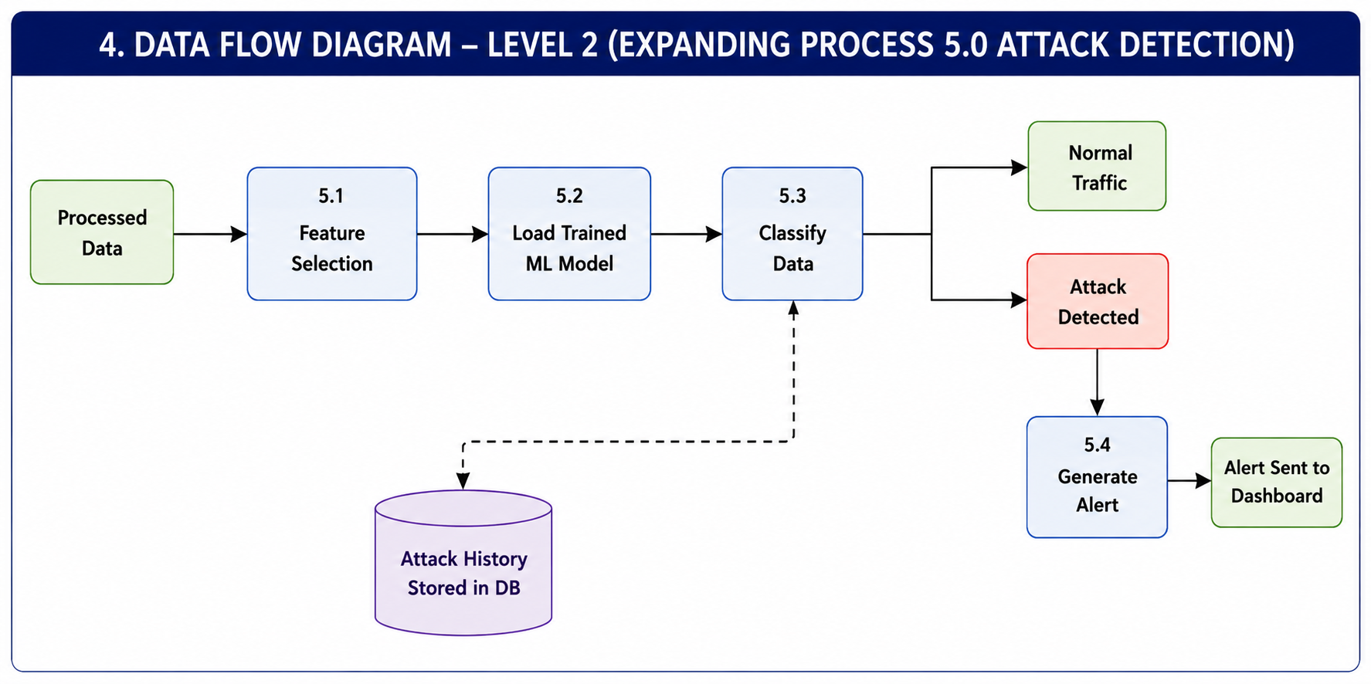

Slide 13
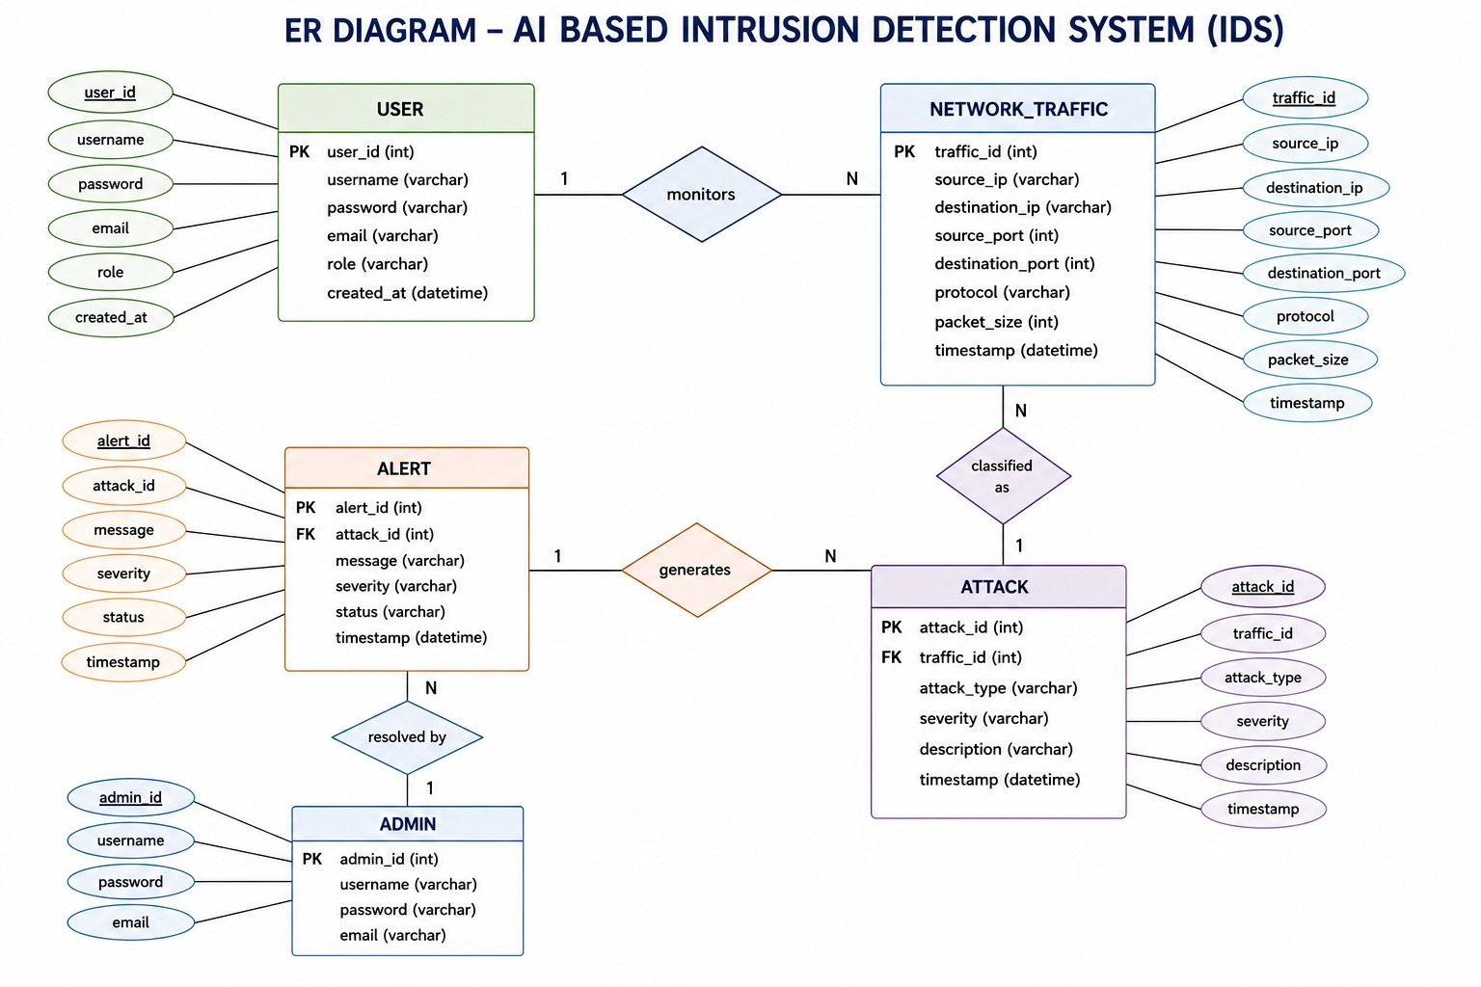

Slide 14
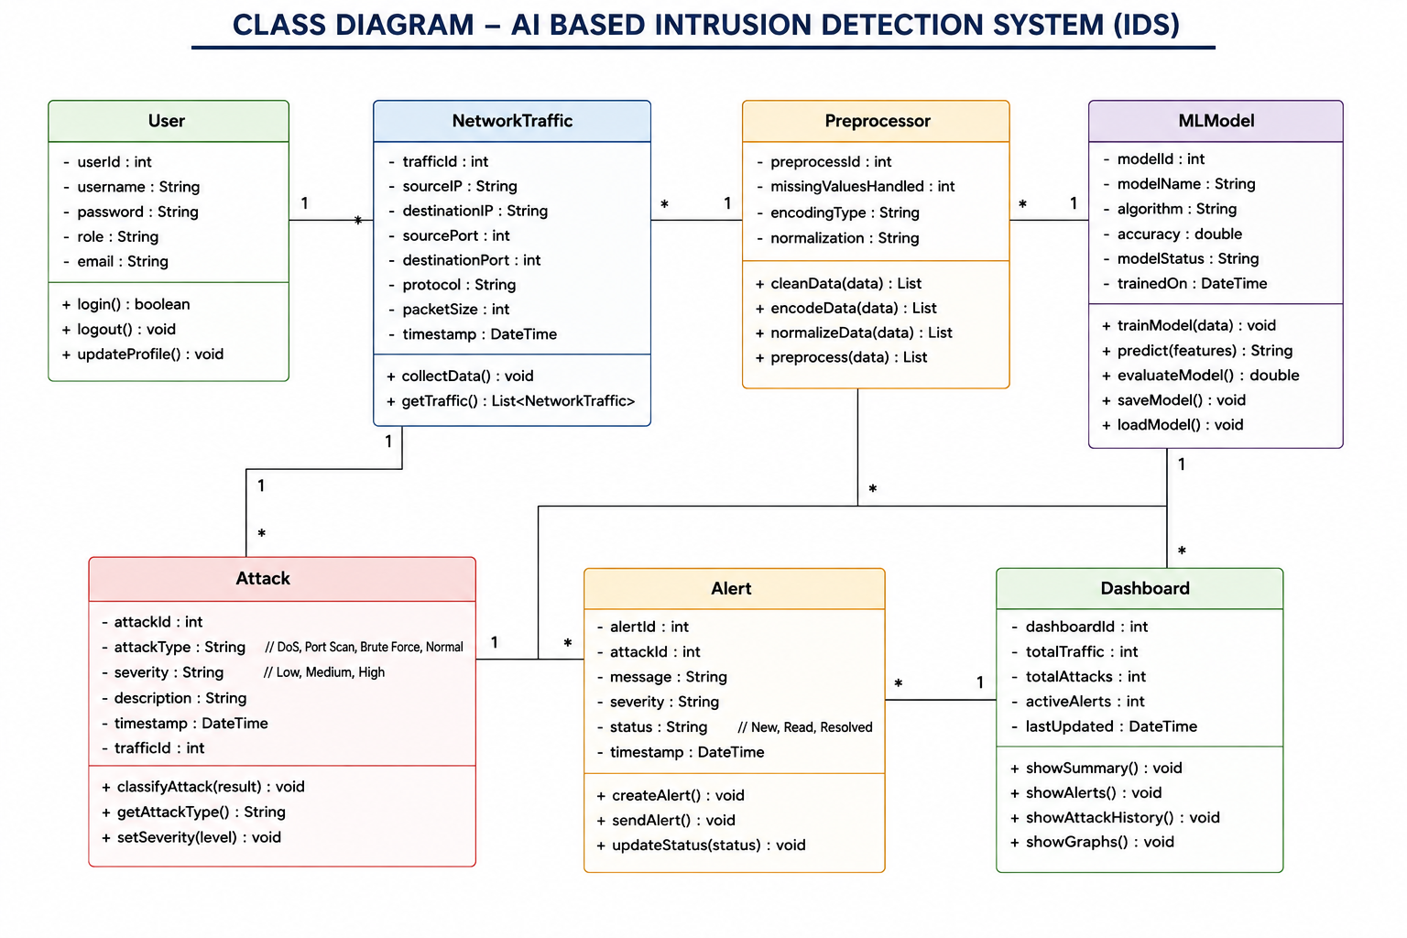

Slide 15
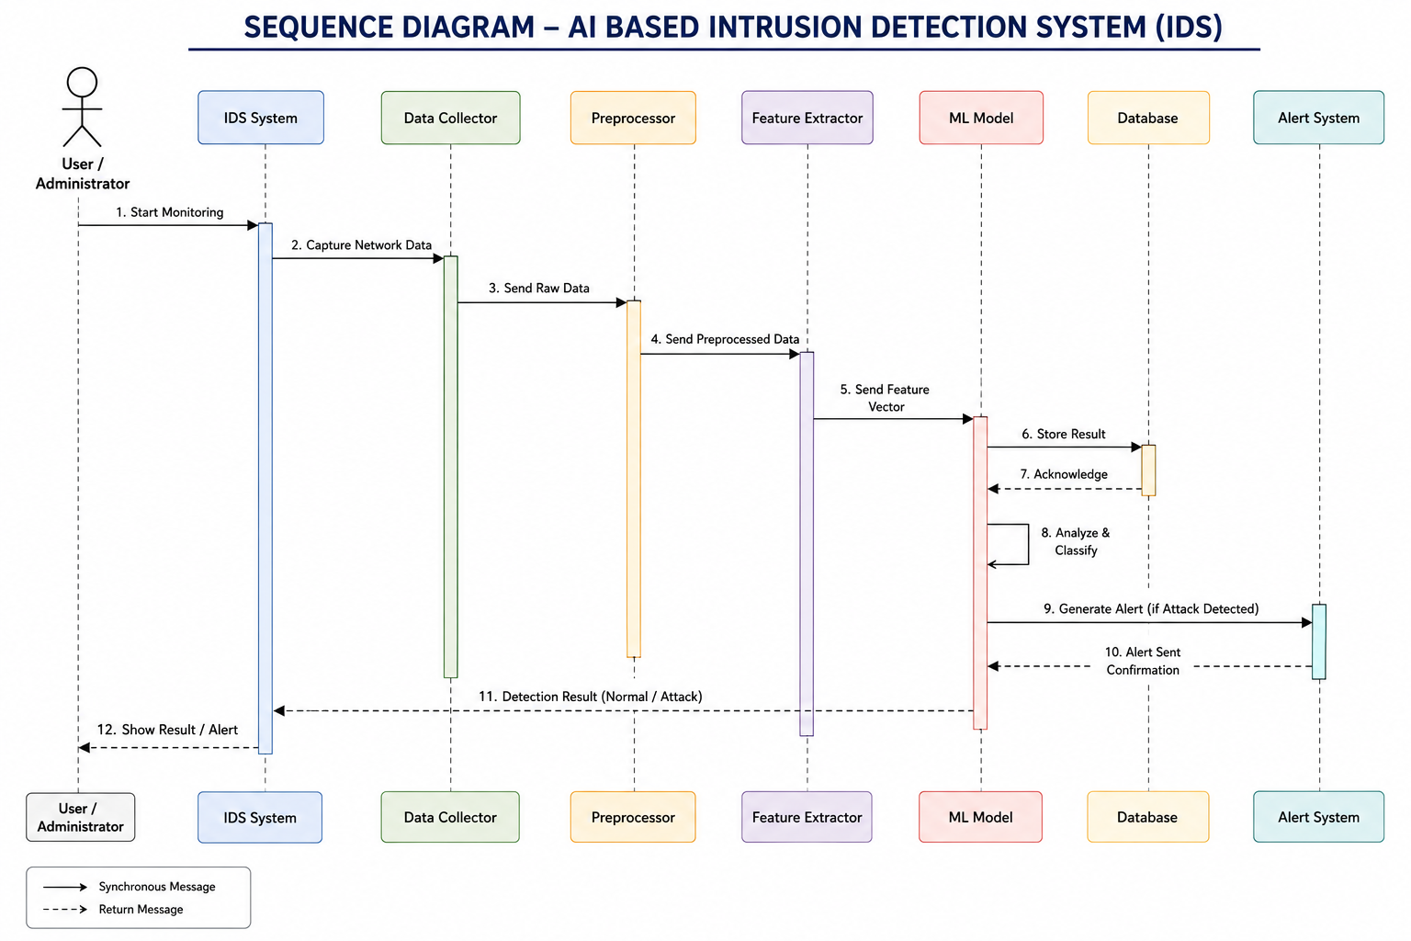

Slide 16
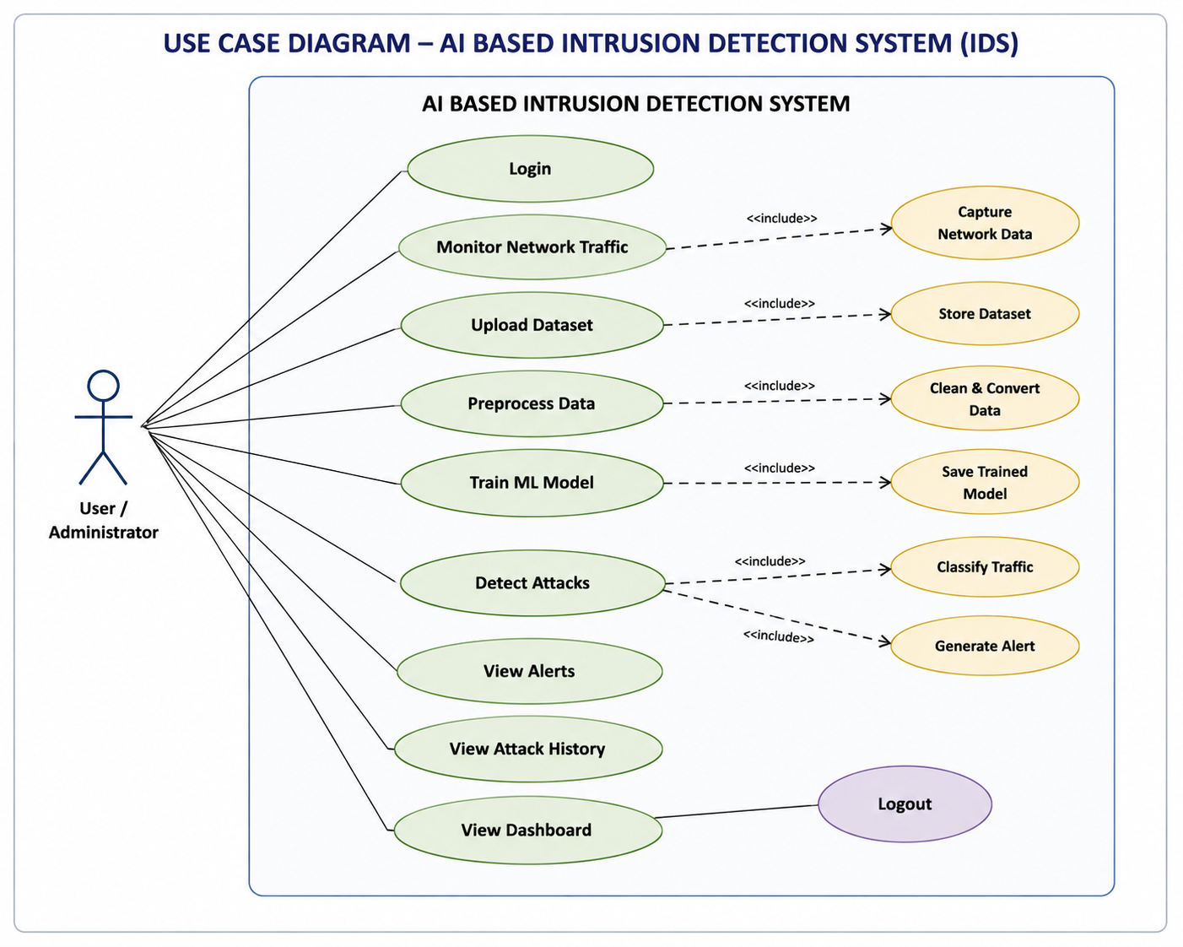

Slide 17
Hardware and Software Requirement
Hardware Requirements:
Processor: Intel i5 or higher
RAM: Minimum 8GB
Storage: 256GB or higher
Internet connection
Network interface card
Software Requirements:
Operating System: Windows / Linux
Programming Language: Python,TypeScript(.ts/.tsx),JS(ES6+),HTML5/JSX.CSS3/Tailwind CSS,SQL
Libraries: TensorFlow / Pandas, NumPy, Scikit-learn
Visualization Tool: Streamlit / Flask
Dataset: CICIDS2017 (Kaggle) ,NSL-KDD(Kaggle)
IDE: Antigravity / VS Code

Slide 18

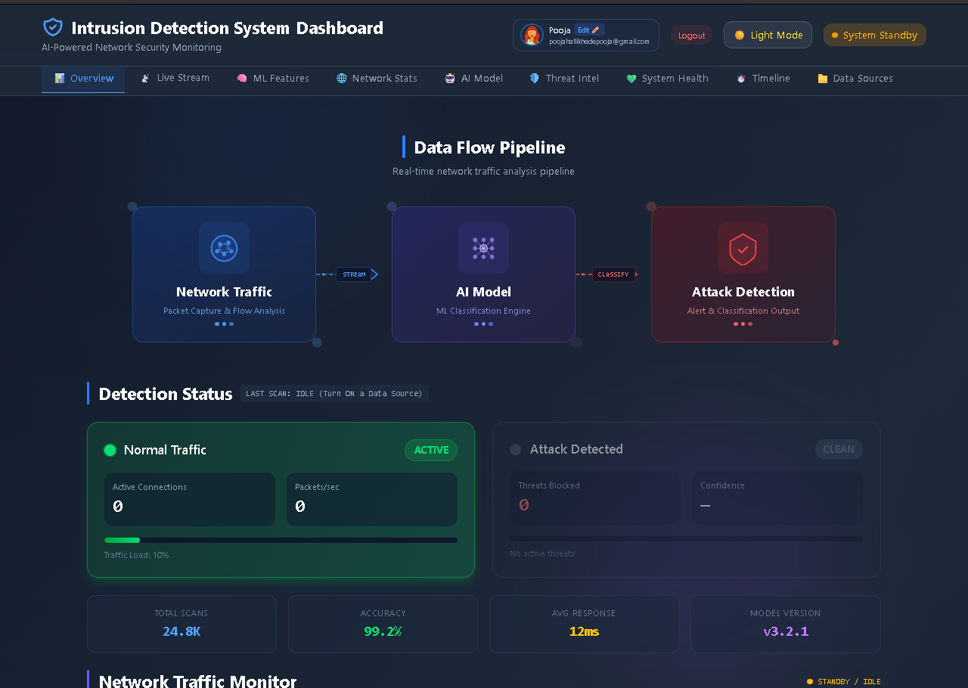
Result Analysis

Slide 19
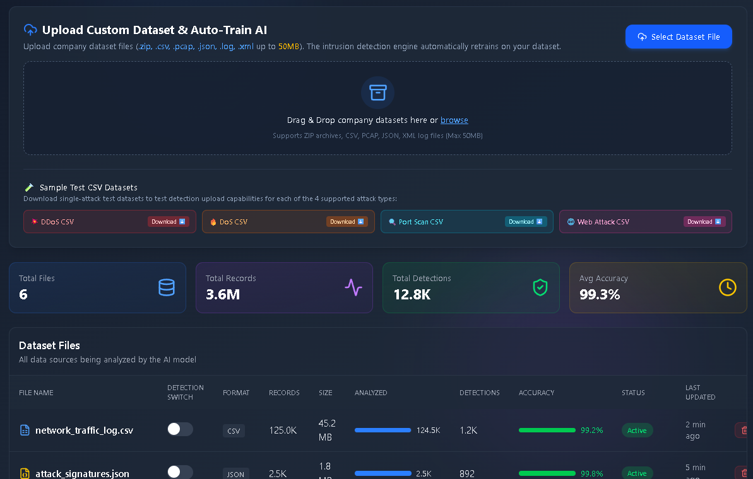
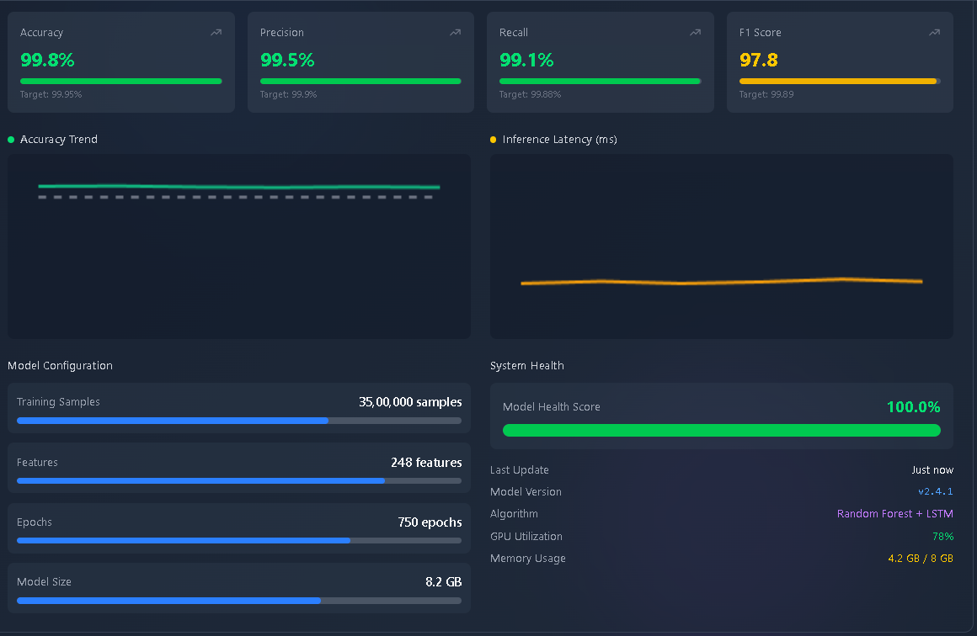

Slide 20
Conclusion
The proposed AI-Powered Real-Time Intrusion Detection System enhances cybersecurity by integrating deep learning with network traffic analysis. Unlike traditional rule-based systems, the proposed model adapts to new and unknown attack patterns, improving accuracy detection and reducing false alarms. The integration of a real-time dashboard further strengthens usability by providing clear threat visualization and actionable insights.
This project demonstrates how artificial intelligence can significantly improve modern network security systems and provides a scalable foundation for future research and real-world deployment in enterprise environments.

Slide 21
References
Neha, Tarunpreet Bhatia, Adaptive Intrusion Detection System Leveraging Dynamic Neural Models, IEEE, 2025.
Elvin Li et al., SAFE: Self-Supervised Anomaly Detection Framework, 2025.
Jayant Biradar et al., Attention Augmented GNN-RNN Models for IDS, 2025.
Abdelkader El Mahdaouy et al., Deep Learning for NetFlow-Based IDS, 2026.
Guerra et al., GraphIDS: Self-Supervised Graph Representation Learning, 2025.

